Slide 1
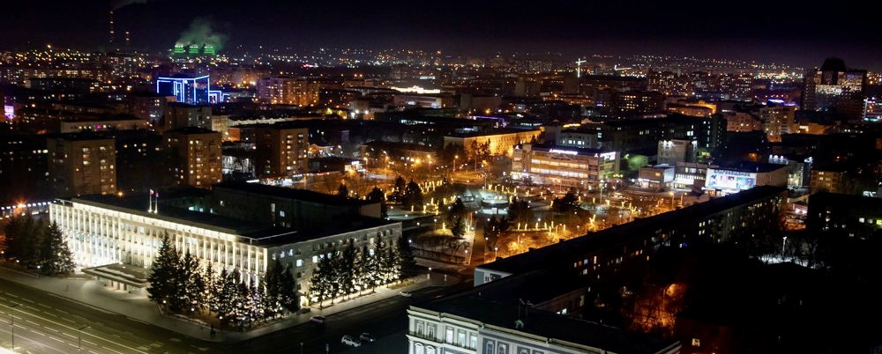
Investment Portfolio of
Blagoveshchensk City
ДОБРО ПОЖАЛОВАТЬ В БЛАГОВЕЩЕНСК!
2023

Slide 2
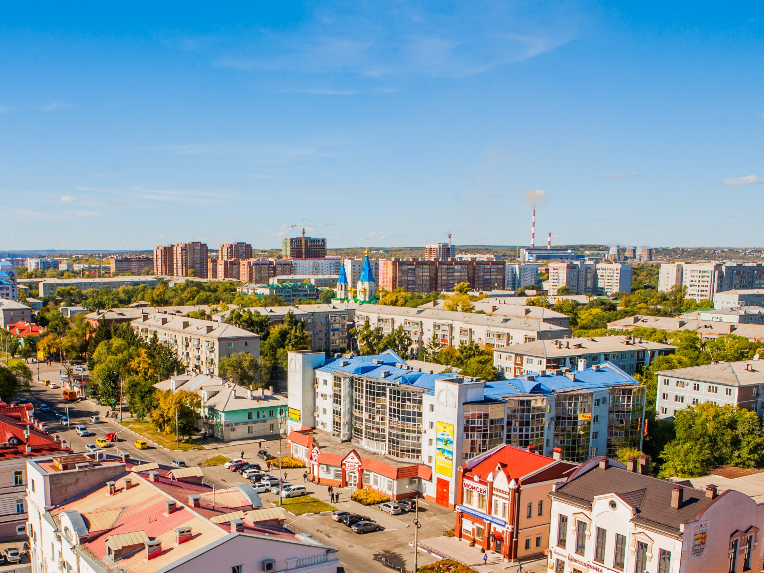
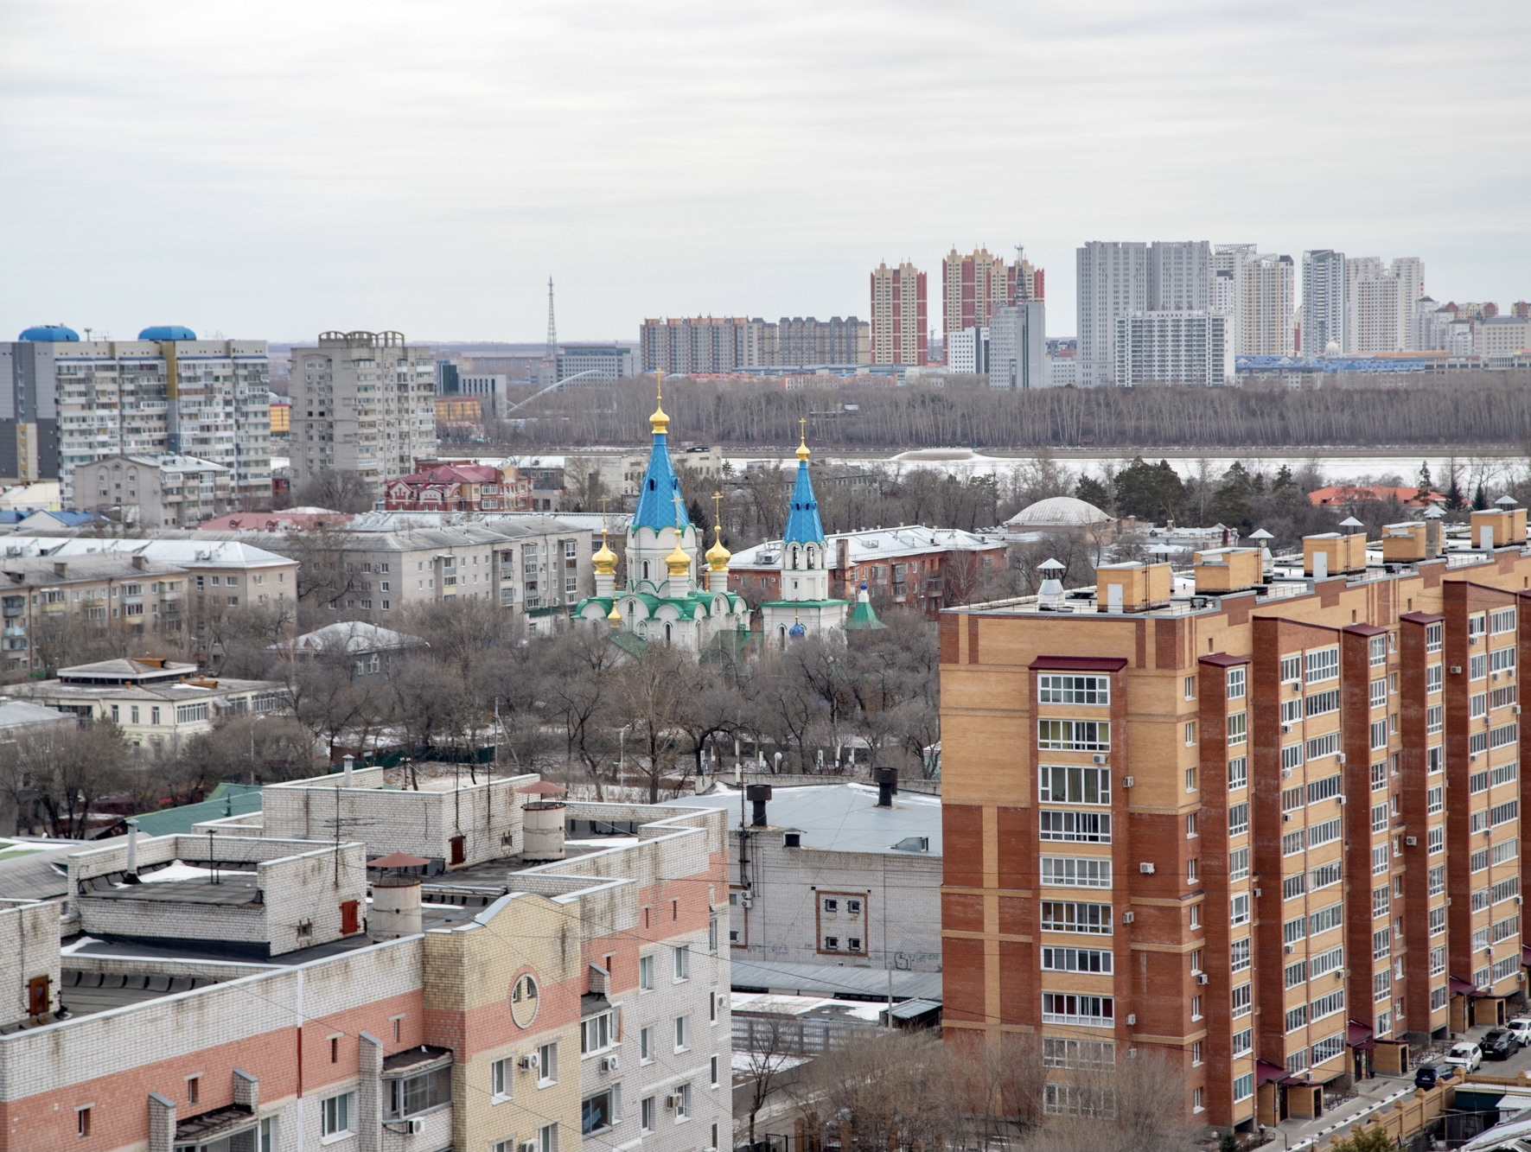
The publication contains information for 2022

Slide 3
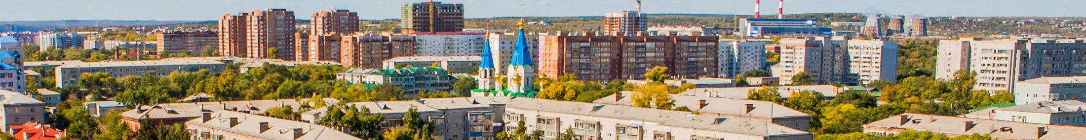
3
Contents
Address by the mayor of the city of Blagoveshchensk………………………………………………………………… | 4
General information……..……………………………………………………………………………………………………………. | 7
Logistics and communications………………………………………………..……………………………… ………………… | 9
Population and labour force…………………………………………………………………… …………………………..…… | 11
Tourism………………………………………………………………………………………………………………………………..……. | 13
Social infrastructure…………….……………………………………………………………………………………………..…….. | 16
Economic potential…….……..…………………………………………………………………………………………………..….. | 18
Investment climate………….…………………………………………………………………………………………………….…… | 22
State and municipal support of investment activity……………………………………………….………..………… | 23
Investment projects………….……………………………………………………………………………………………..………… | 24
Legal regulation of investment and business activities…………………………………………..………………….. | 42
The support of investment and business activities…………………………………………………………….….…… | 45
Reference information for investors and entrepreneurs…………………………………………………….………. | 49

Slide 4
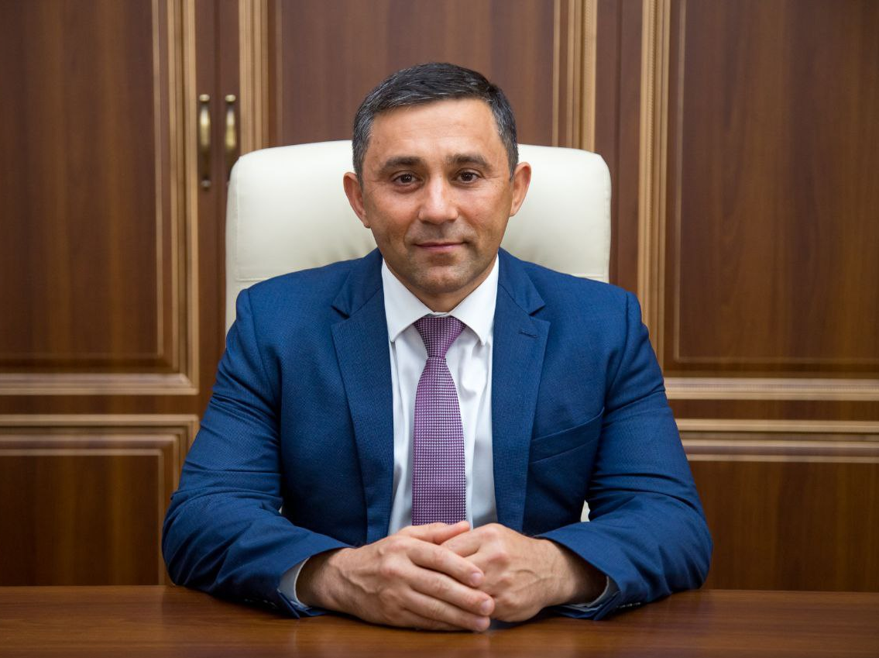
4
The mayor’s address

Slide 5
5
Dear investors and entrepreneurs!
Our city was founded in 1856 as the Ust-Zeya military post on the Amur, on the border with China. Today Blagoveshchensk is an administrative, political, business, industrial, scientific, educational and cultural center of the Amur Region. The city administration does its best to increase the attractiveness of the business climate of the capital of the Amur Region.
The unique geographical location on the border with China, the presence of a customs crossing and a developed transport infrastructure - an international airport, railway, road, river transport - contribute to strengthening the economic and social cooperation between Russia and China. The cross-border bridge and cableway across the Amur River open up new opportunities for the development of tourism, trade and industrial production.
Large investment projects are being implemented on the territory of Blagoveshchensk, the city is open to new business partners. Our investment policy is aimed at supporting competitiveness, reducing administrative barriers, supporting promising projects and establishing effective cooperation with investors in all industries.
We are ready for dialogue with the investment community.
We invite you to evaluate the investment potential of our city and the prospects for joint work.
The mayor of the city of Blagoveshchensk
Oleg Imameev

Slide 6
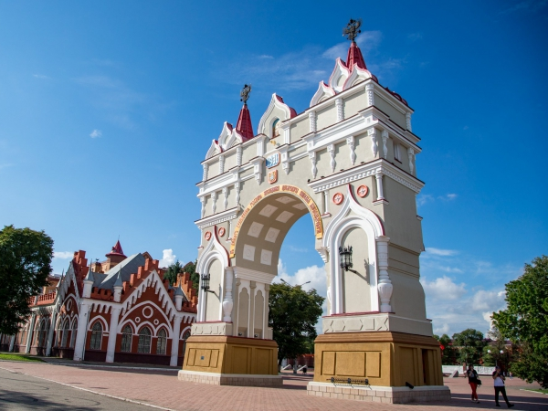
6

Slide 7
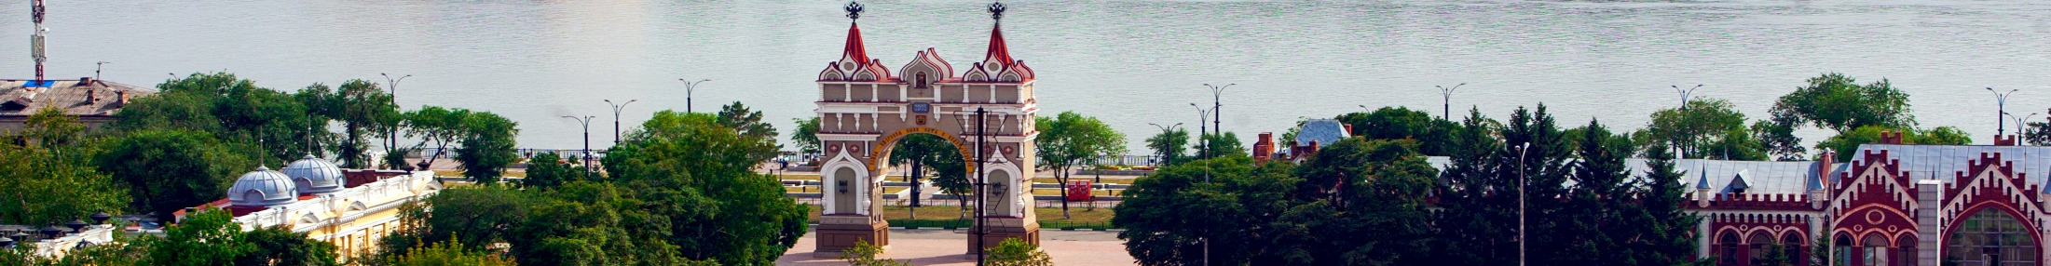
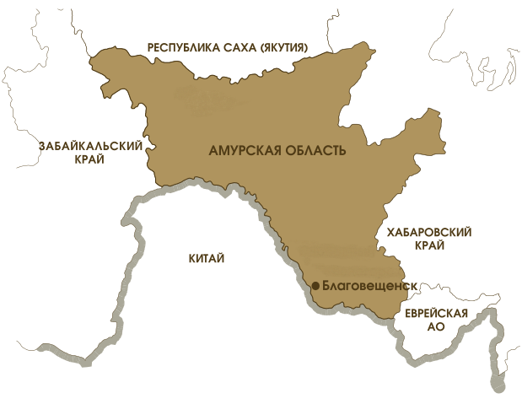
7
General information
The Sakha (Yakutia) Republic
Foundation date: 1856 year
Total area: 321 square kilometers
Population: 246,3 thousand people
Population density: 766 people per square km
The territory of Blagoveshchensk includes villages: Belogorie village, Mukhinka settlement, Belogorie and Prizejskaya railway stations, Plodopitomnik village, Sadovoye village.
Climate conditions: Blagoveshchensk is located in the south of Amur region in temperate geographical zone, monsoon climate prevails. The average temperature of January : – 30,2°С, The average temperature of July: +20,8°С.
Time zone: UTC+9/MSK+6. Calling code: +7 4162.
Natural resources: The city of Blagoveshchensk is located on the left bank of the Amur river, where the Zeya river goes into it. The Burhanovka and the Chigiri rivers flow in the Amur-Zeya river valley on the territory of the city. Plantation of trees in the modern area of the city is 11 783,0 hectares, which corresponds with 36,7% total area of the city. The largest area is occupied by city forests - 11 185 hectares, which are located as large tracts and consist of Mongolian oaks, birches and pine trees, which are also valuable for recreation.
Minerals: There are rather rich reserves for mineral deposits within the territory of city district: natural sand, quartz sand, construction sand, pebble, gravel, ballast, peat, loam for M 125 bricks, clay for ceramic bricks, loam for M 500 expanded clay, clay for expanded clay, granodiorite for processing ballast into concrete, silicate sapropel.
Zabaykalsky Krai
Amur region
Khabarovsk Krai
China
Blagoveshchensk
The Jewish Autonomous Oblast
Blagoveshchensk is the administrative center of Amur region and is located in the Far Eastern federal district of the Russian Federation.
The city of Blagoveshchensk is the only one among other regional capitals of the Russian Federation which is located on the state border. Blagoveshchensk and the Chinese city of Heihe are divided by 800 meters of the Amur river.

Slide 8
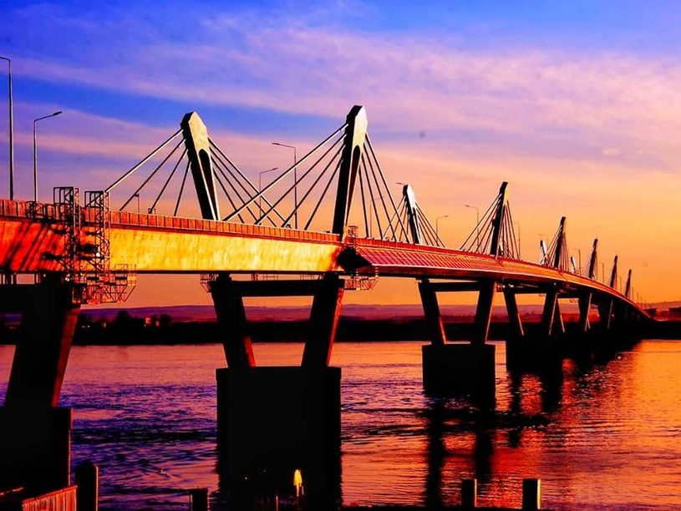
8

Slide 9
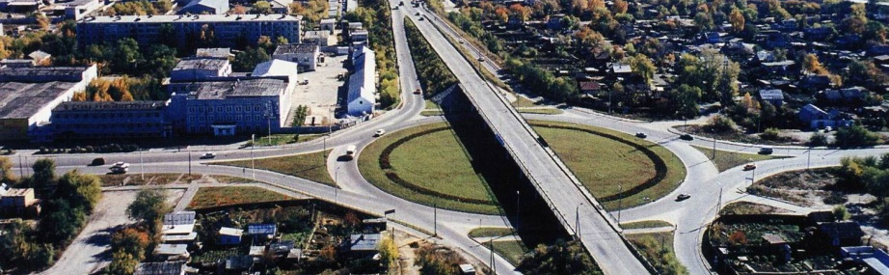
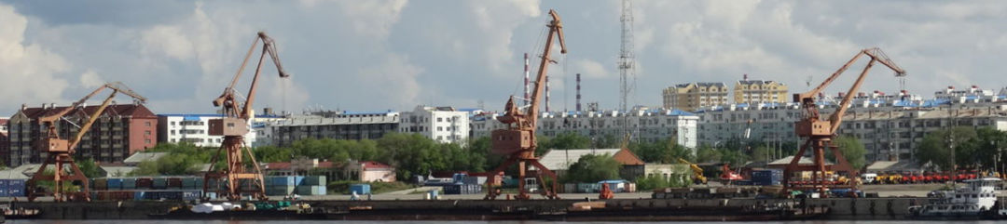




9
Logistics and communications
Blagoveshchensk is one of the most developed border cities of the Far East. It has the formed logistics: railway, air, river and road transports. The customs is the transit center for tourists and for product’s import and export as well.
Road transports
Railway transports
The total length of the municipal route network (in one direction) is 535.85 km.
Trucks' freight turnover of large and medium-sized enterprises of all types of economic activity in 2022 was 149 933,5 thousand tons-km.
Passenger turnover of road public transport was 132 751,9 thousand passenger-km.
The railway station "Blagoveshchensk" is a freight station of the 1st class with a parallel arrangement of parks. The volume of loading and unloading operations performed is more than 3.8 million tons per year. Long-distance trains run through the station in the following directions: Moscow; Chita; Tynda; Khabarovsk; Nizhny Bestyakh (Yakutia); Vladivostok; Belogorsk.
Inland water transport
2 big enterprises of river transport:
CJSC «Blagoveshchensk Trade Port»
transportation and transhipment of soya, coal, container, timber, unitized cargo, bulk cargo
non-metallic building materials mining
In the summer, cargo ferry crossing is on work, but in the winter it is pontoon bridge, which connects Chinese and Russian ports.
CJSC «AmurASSO passenger port»
Transportation of passengers and cargoes, including outsized cargo
Loading and unloading operations
Warehousing
Customs clearance of goods
Air transports
Blagoveshchensk Airport is part of the national core airport network and is included in the list of airfields of federal significance. The class B runway allows servicing all types of aircraft and helicopters of domestic foreign production. Passenger transportation is carried out in domestic and international directions. About 400.0 thousand passengers are transported annually.
Directions of The Blagoveshchensk airport (Ignatyevo)
Moscow
Vladivostok
Irkutsk |  |  |  |  |  | Komsomolsk-on-Amur
Chita |  |  |  |  |  | Svobodny
Khabarovsk |  |  |  |  |  | Oktyabrsky
Yakutsk |  |  |  |  |  | Zeya
Novosibirsk
Ulan-Ude |  |  |  |  |  | Tynda
Yekaterinburg |  |  |  | Domestic Russian flights
Yuzhno-Sakhalinsk |  |  |  | Intraregional flights
Magadan
Communications
General operator of fixed communications and internet service provider is “Rostelecom”.
Cellular operators: “MTS”, “Beeline”, «MegaFon», «Yota». In the city of Blagoveshchensk there are GSM- and CDMA- communications of Chinese operators China Mobile and China Unicom.
Krasnoyarsk

Slide 10
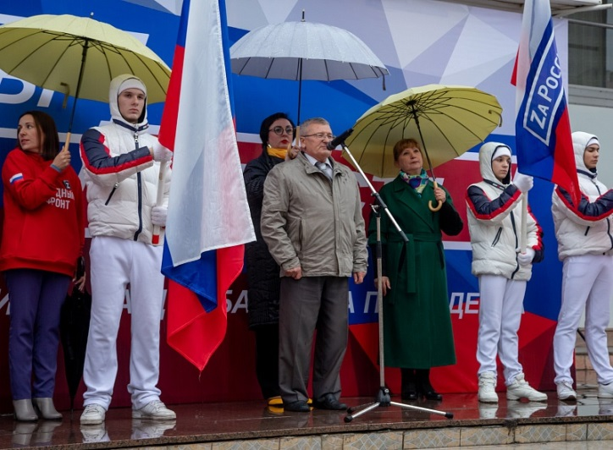
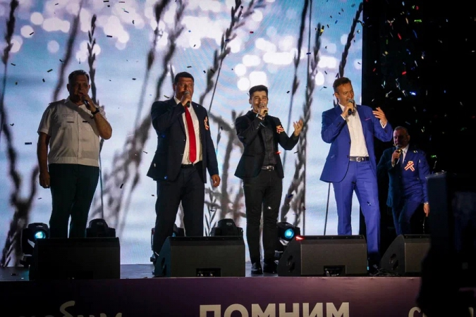
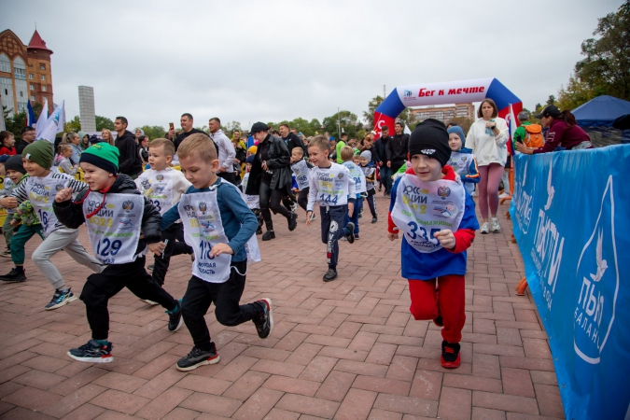
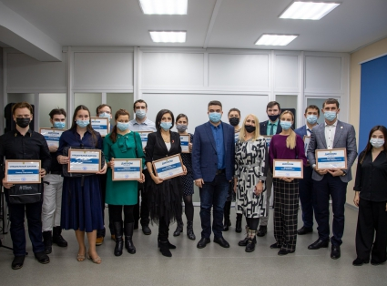
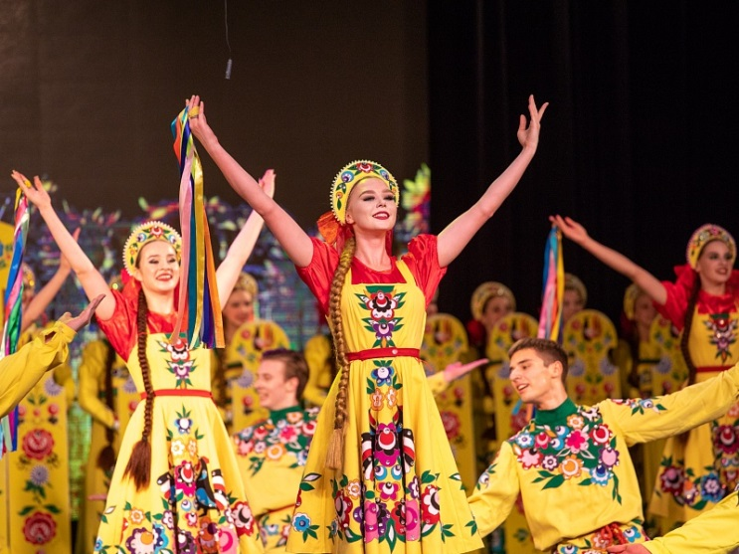
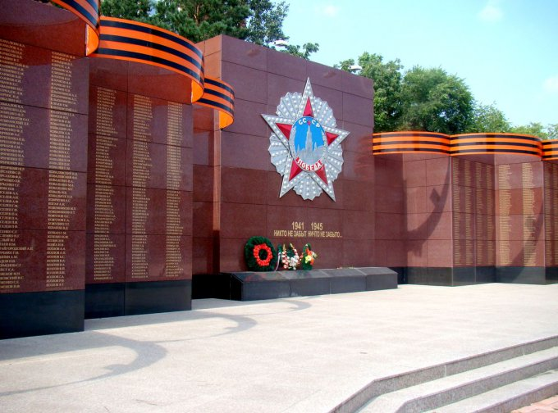
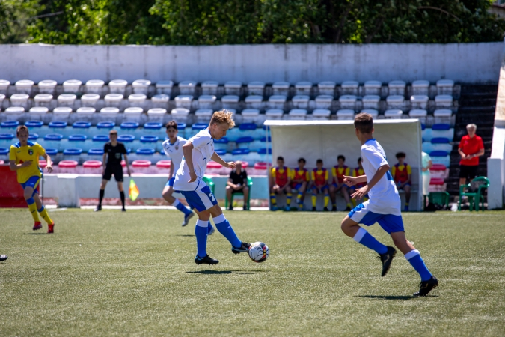
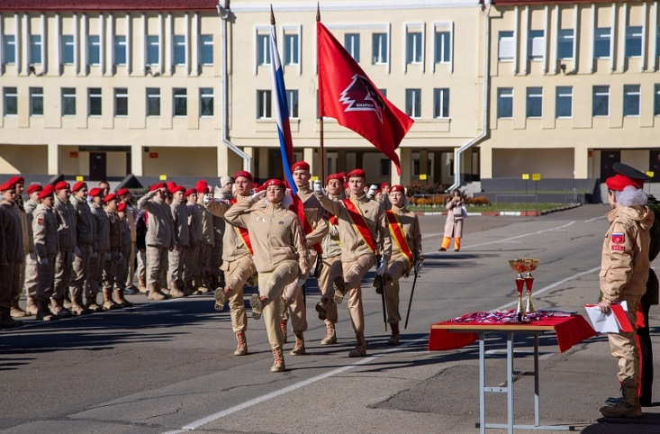

10

Slide 11
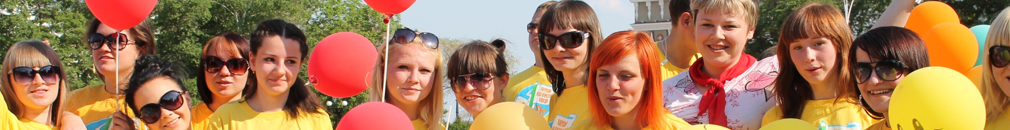
11
Population and labour forces
Population of the city of Blagoveshchensk
61,2% - | working age population
20,3% - | population in retirement age
18,5% - | Children up to 16 years
According to Rosstat, taking into account the results of the All-Russian Population Census of 2020, the permanent population of the city of Blagoveshchensk on 01.01.2023 is 246 006 people and in January-December 2022 decreased by 520 people. Or 0.2%. The average annual population for 2022 is 246 264 people.
Dynamics of population of Blagoveshchensk from 2011 to 2022 (in thousands)
240,6 thousand people - urban population (97,6%)
During the last ten years population of Blagoveshchensk has increased by 8,9 thousand people. Since 2012 there is natural population growth. However, starting from 2020, there has been a decline in population growth, which can be explained by the sanitary and epidemiological situation in recent years.
Average age of citizens is 35 years.
The population of working age is 141,5 thousand people.
5,4 thousand people – rural population (2,4%)

Slide 12
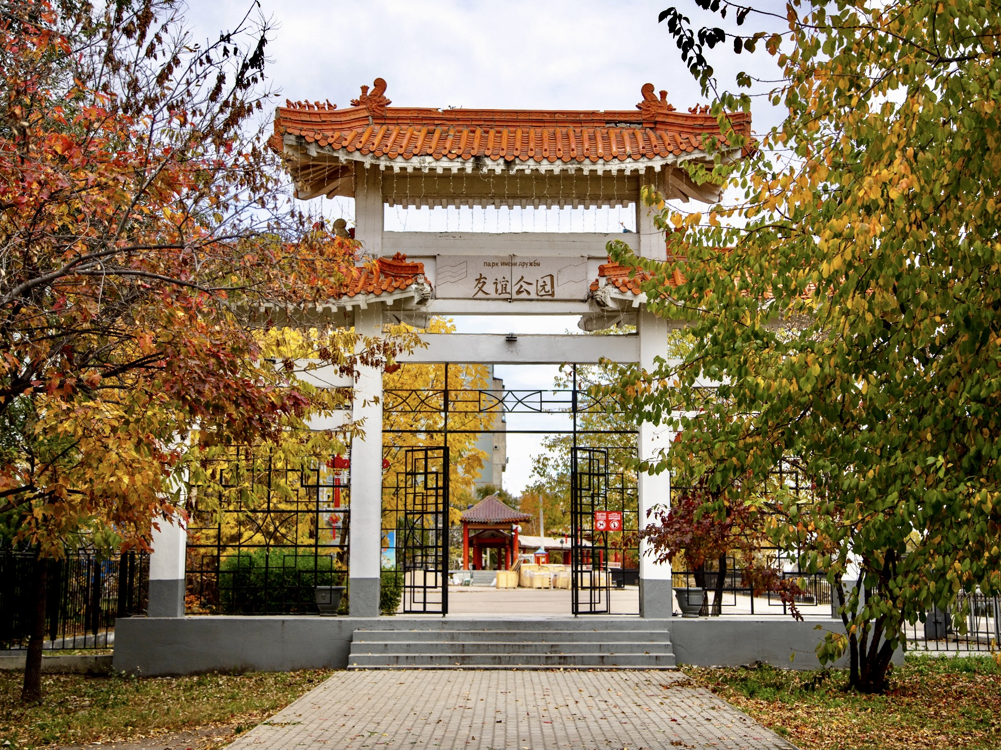
12

Slide 13
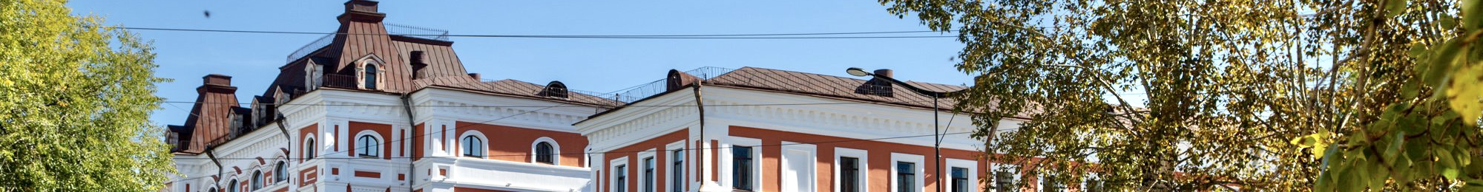
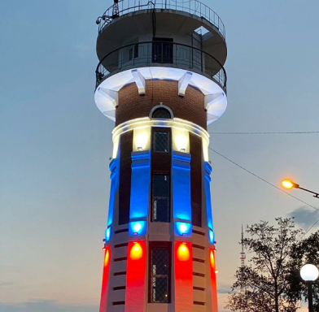
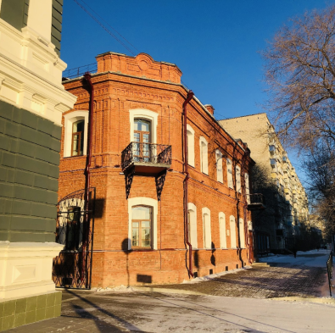
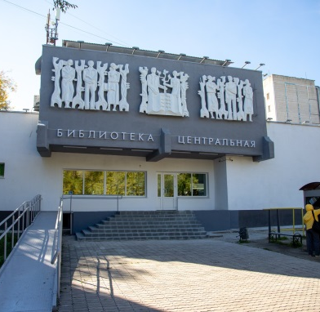
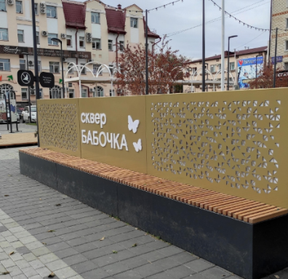
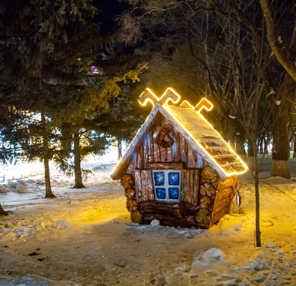
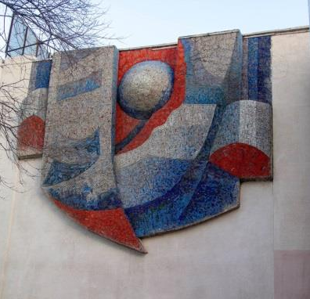
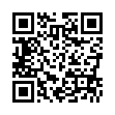
13
Tourism
The city of Blagoveshchensk possesses great tourism potential.
Flow of inbound tourism
A long history and unique attractions make the city attractive for the inbound tourism development. Here you can see: the oldest on the Far East Amur Regional Drama Theatre, Novikov-Daurskiy Amur Regional Museum, diocesan female school (now Amur Pedagogical College) which was opened in 1901 by a decree of the Holy Governing Synod, the first city public library founded in 1859, the marine college, operating since 1899 (now Amur branch of the Admiral G.I. Nevelskoy Maritime State University), Alekseevskaya female grammar school (now Municipal autonomous educational institution "Alekseevskaya Gymnasium of Blagoveshchensk"), which is operating since 1912.
99% foreign consumers of tourist services – Chinese tourists
Tourist interest in Blagoveshchensk is represented by blocks of wooden buildings with allotment gardens of 19th century, brick buildings of the early 20th century, excavations of ancient pangolins, which are located in the city area.
Hotels and other accommodation facilities – 37
(number of rooms 1353)
Tour operators - 16

Slide 14
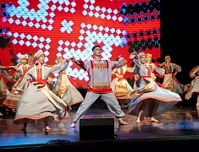
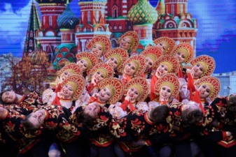
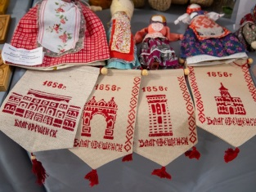
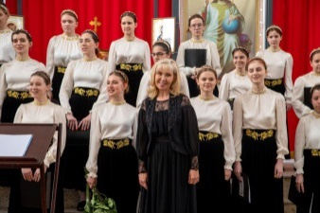
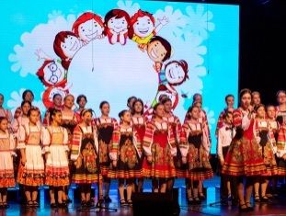
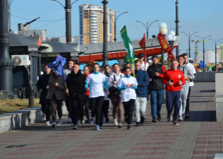
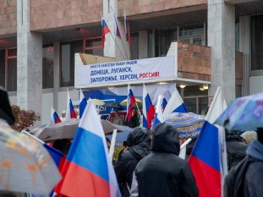
14
Tourism
Domestic tourism development is the priority direction of tourism, including business, event, culture and active tourism.
The city of Blagoveshchensk has a favorable geographical location, which creates all the prerequisites for the development of tourism. The Russian city of Blagoveshchensk in the Amur Region and the city of Heihe in the Heilongjiang province of China are the only pair of cities located on the border of the two states.
Despite the fact that for many years residents of the neighboring state have been leaving the basis of the tourist flow, the sanitary, epidemiological and geopolitical situation of recent years has made its own adjustments, in connection with which projects aimed at the development of domestic tourism have been widely developed.
In 2022, as part of the Year of the Cultural Heritage of the Peoples of Russia, the Year of Respect for the City of Blagoveshchensk, patriotic events aimed at supporting the special military operation in Ukraine, residents of the Donetsk and Lugansk People's Republics, 743 patriotic actions and concerts were held for more than 200 thousand spectators.
For the first time, the city flower festival "City in Color" was held, which united professional florists and flower lovers. The VIII International Festival "Childhood on Amur", supported by the Presidential Foundation for Cultural Initiatives, became a large-scale event in 2022.Within the framework of the traditional VII International Public Writers and Publishers Forum "Capital Publications of the XXI century. Local History – Personality – City" more than 100 events were held at 20 venues of the city: lectures, exhibitions, presentations, master classes, etc.
In its activities to develop friendly and mutually beneficial economic and cultural ties with cities of foreign countries, Blagoveshchensk closely cooperates with the municipal authorities of Russian and foreign cities in the field of economics, education, culture.
International events are widely covered in the mass media, both in Blagoveshchensk and in our foreign partner cities, which helps to attract public attention to issues of strengthening international and twinning cooperation.

Slide 15
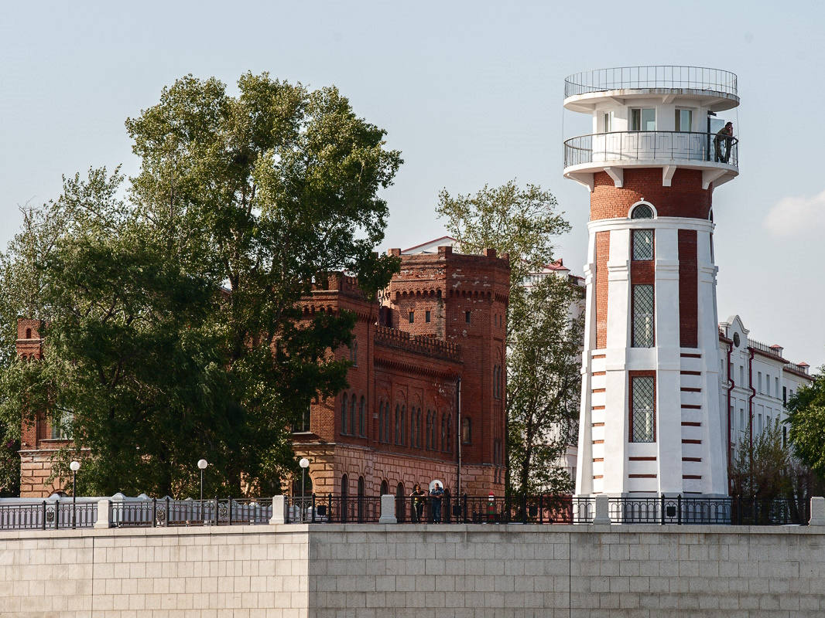
15

Slide 16
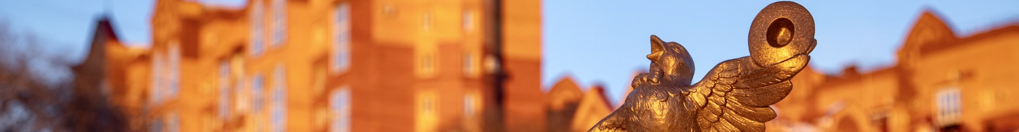
16
Social infrastructure
Education
Health service
Blagoveshchensk is one of the biggest centers of education and science of the Far East. It possesses huge labor force and intellectual potential.
On the territory of Blagoveshchensk there are 28 treatment and prevention institutions:
9
outpatient hospitals
12
hospitals
4
health facilities of a specific type
20
Pre-school educational institutions
21
Comprehensive institutions
1
blood transfusion station
1
ambulance
station
1
orphanage
11
Vocational education institutions
4
Universities
Culture
Physical Culture and Sport
97,2 thousand citizens do sport on a regular basis. Annually about 275 sport events are hold in the city.
On the territory of the city there are:
2 + 10 branches
cultural and leisure centers
3
Public amusement parks
5
Art schools for children
7 sport schools for the youth
Amur Regional Research and Children’s libraries,
Municipal information library system, which unites 12 libraries
Amur Regional Puppet Theatre,
Amur Regional Drama Theatre
420
sport facilities,
including:
89
gyms
6
swimming pools
3
stadiums with stands
Amur Regional concert hall
Novikov-Daurskiy Amur Regional Museum

Slide 17
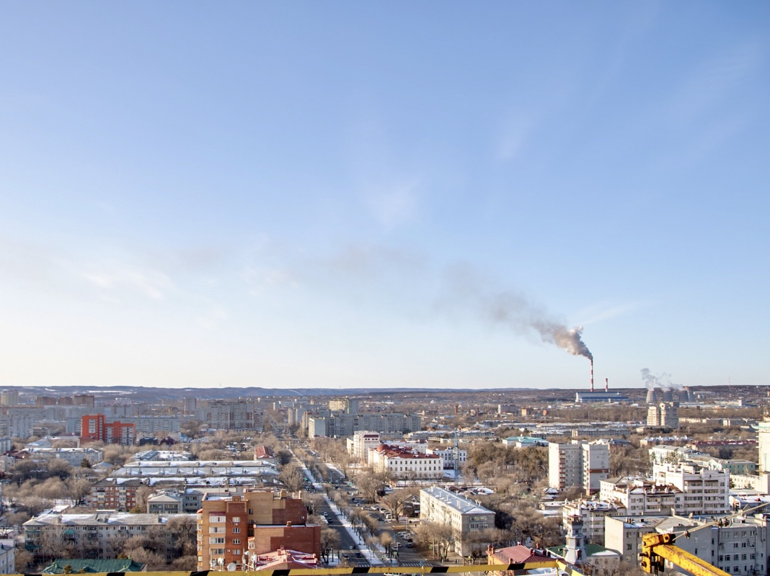
17

Slide 18
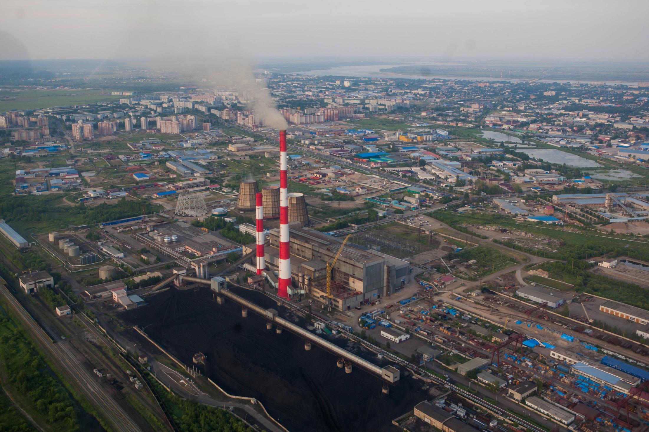
18
Economic potential
Economic and social indicators of development of Blagoveshchensk in 2021
Structure of fixed-capital investments (excluding SMEs). Types of economic activities, %
Turnover of organizations, which are not classified as small business enterprises (including medium-sized businesses) –
232028,9 million rubles
Share of profitable enterprises (excluding small business enterprises) –
69,1%
Amount of new housing –
136,8 thousand square meters
Amount of “Building” sector –
16416,6 million rubles
Retail turnover –
54496,9 million rubles
Amount of paid services for citizens –
16765,8 million rubles
Average nominal monthly wages (excluding small business enterprises) – 68607,9 rubles
Amount of fixed-capital investments (excluding SBE).
Sources of funding, %
Self-possesed funds – 61,1%, budget resources – 32,7%, bank credit – 0,9%, off-budget funds – 0,3%, borrowed funds of other organizations – 3,5%, others – 1,5%.
44 321 million rubles

Slide 19
19
Economic potential
Amount of shipped products and amount of workers in types of economic activities in 2022, %
Amount of shipped products
Amount of workers
62,7 thousand people
Structure of manufacturing industry products
Foodstuffs
In Blagoveshchensk there are huge foodstuffs diversity (poultry meat, sausages, semi finished meat and meat-containing products, butter, whole milk products, confectionery and pasta), publishing and printing products, electrical equipment, various building materials and furniture.
21255,0 million rubles
Repair and installation of machinery and equipment
26 694 million rubles
Others

Slide 20
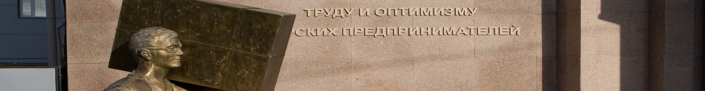
20
Economic potential
Small and medium enterprises (SME)
The structure of small business enterprises in types of economic activities
Total amount of small (including microenterprises) and medium enterprises (excluding sole trader) were 6545 units in 2022.
There were 7529 sole traders in 01.01.2023
The main share in the total number of small and medium-sized businesses is:
Microenterprises
95%
Small business enterprises 4,8%
Medium-sized enterprises 0,2%
The amount of SME in the average number of employees of all enterprises and organizations of Blagoveshchensk is 70,1%.
Income from products realization (service provision)
180 526,9
million rubles
Tax revenue
19 416,2
million rubles
Support for SMEs
Support for SMEs on the territory of Blagoveshchensk city is realized within the framework of municipal program “SMEs and Tourism Development in Blagoveshchensk City Area”, which includes “SMEs Development in Blagoveshchensk City” subprogram. This was approved by decree (03.10.2014 № 4129) of Blagoveshchensk city administration.
Support for SMEs includes financial, property, informational, consulting and organizational support services.

Slide 21
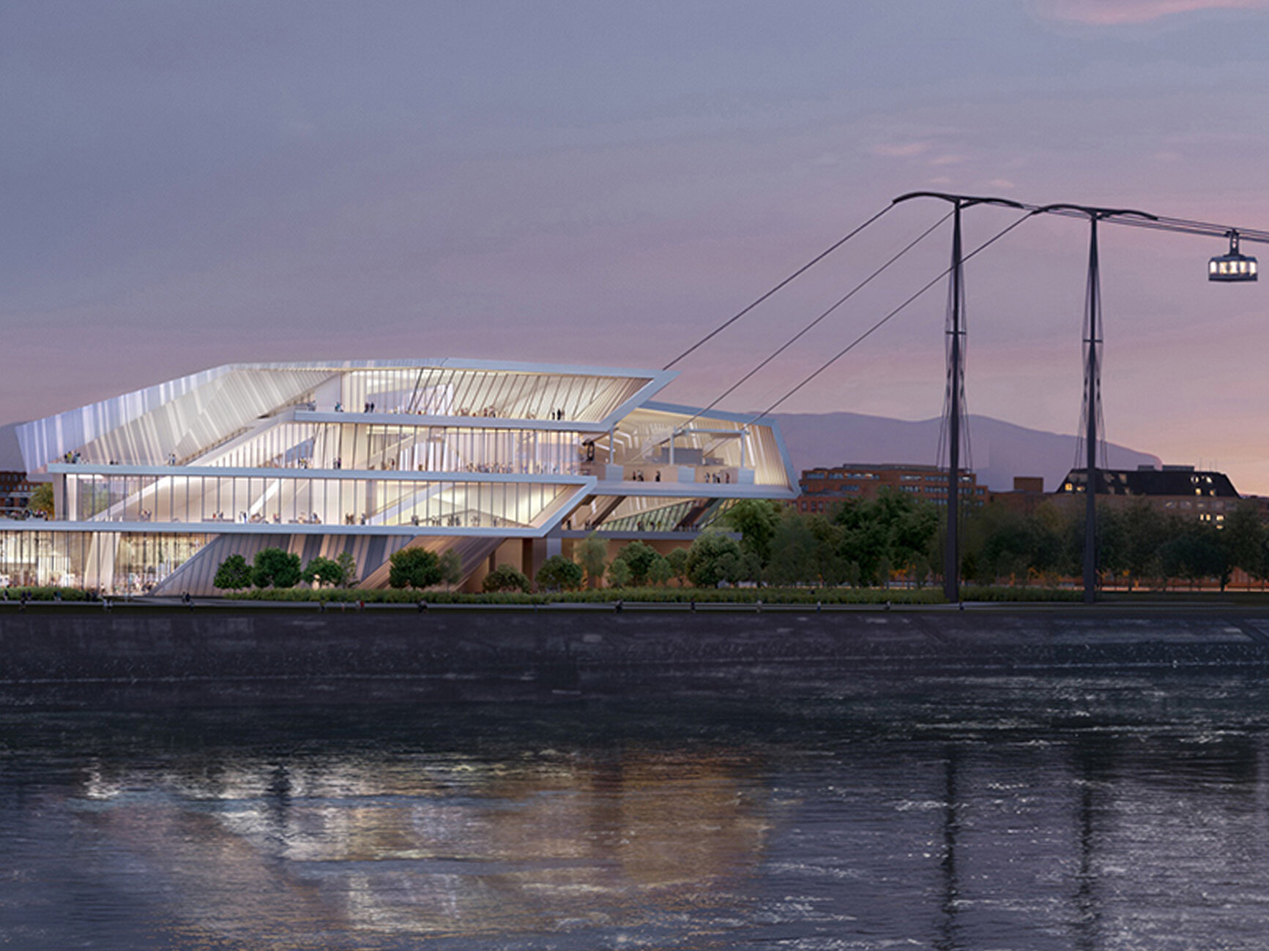
21

Slide 22
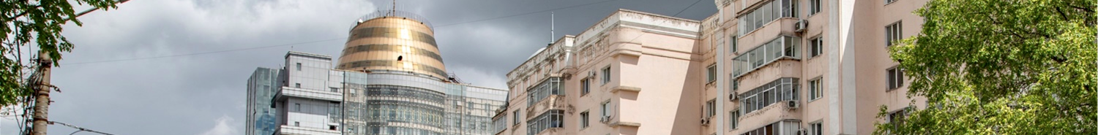
22
21
Investment climate
Investment climate
Competitive advantages
Modern development institutes
Regional and municipal institutions, institutes of modern development are located on the territory of Blagoveshchensk:
Business and Investment Support Center "My Business"
Agency of the Amur Region for Attracting Investments
Credit assistance fund of SME of Amur region
Council of improving investment climate and developing entrepreneurship under the lead of the mayor of Blagoveshchensk
Amur Regional Microcredit Company
Blagoveshchensk city Multifunctional center of providing state and municipal services
Amur Regional Chamber of Industry and Commerce, OPORA Russia, Business Russia, Industrialists, Entrepreneurs and Employers Union of the Amur Region, institute authorized to protect the rights of entrepreneurs and many others are all-Russian organizations which represent small business enterprises.
Individual approach to investors
Equal treatment for domestic and foreign investors
Complete project support in the "one stop" regime
Scale
Blagoveshchensk is the administrative center of Amur region. Population — 246,3 thousand people. It is the sixth biggest city in the Far East..
Advantageous geographical location
The city is located on the left bank of the Amur river and on the right one of the Zeya river. It is the only one among other regional centers of the Russian Federation which is located on the state border. Chinese city of Heihe is on the right bank of the Amur river. There is a railway which provides railway junction with the Trans-Siberian Railway.
Developed education system
The city has the developed system of colleges, universities and research institutuons.
Developed business infrastructure
In Blagoveshchensk there are: 24 credit organizations, 13 insurance organizations, 12 leasing companies; consulting, advertising and employment agencies; audit firms.
City attractiveness
Blagoveshchensk has the developed real estate and consumer market, high availability of medical organizations and institutions of health, education and culture.
Resources
There is the resource base for enterprises which work in sphere of producing building materials and food products.
“Growth points” of the city of Blagoveshchensk
Tourism and recreation
Logistics and connection
Processing industry

Slide 23
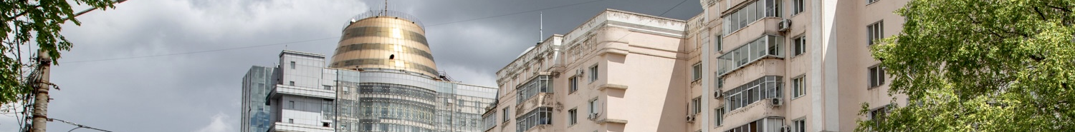
State and municipal support of investment activity
23
Municipal support of investment activity
State support of investment activity
Tax preferences
Establishment of differentiated tax rates for corporate property tax of certain taxpayers' categories;
Establishment of reduced profit taxes, which should be entered in Amur region budget at the rate of 13,5% for certain taxpayers' categories;
Establishment of profit tax rates, which should be entered in Amur region budget. During the first five tax periods - 0%, during the next five tax periods - 10% for projects, which have "Regional investment project" status according to the Federal Law 30.09.2013 № 267-FL;
Establishment of differentiated tax rates in using simplified taxation system.
Establishment of zero tax rate in using simplified taxation system during the first two tax periods for taxpayers – sole traders, who are for the first time registered and who carry out various types of activities;
Establishment of tax rate in the amount of 0% in using patent taxation system during the first two tax periods for taxpayers – sole traders, who are for the first time registered and who carry out various types of activities;
Providing the investment tax credit;
Deferral or installment in paying regional taxes.
Lands, buildings, structures owned by Amur region are available for rent on preferential terms.
Provision of guarantees on obligations (credit, loan) non-commercial organization «Assistance lending fund for SME»
Microloan provision (ANO “Amur Regional Microcredit Company”)
Non-financial support measures
Complete project support in the “one stop” regime - ANO "Agency of the Amur Region for Attracting Investments“
Marketing, informational, law support for SMEs activities, organization of training courses by Enterprise support center, Cluster development center, Export support center of Amur region.
Municipal guarantees for legal entity carrying out economic activity on the territory of the city;
Providing sites of Blagoveshchensk for investment projects realization according to the main strategic directions of the city development;
Benefits which affect land rental rate;
Property support in renting municipal properties that are free from any right or claim of a third party (excluding property rights of SME);
Organizational, informational, consulting support;
Support for SME:
Subsidies program of part of the costs associated with the payment of the first installment (advance payment) at the conclusion of equipment leasing agreements
Subsidies program of part of the costs associated with the purchase of equipment for the creation/development/modernization of production
part of the costs of the purchase, repair of non-residential premises, as well as the purchase of building materials.
Non-financial support measures:
Council of improving investment climate and developing entrepreneurship under the lead of the mayor of Blagoveshchensk;
Investment projects support in the “one stop” regime by economic and investment development authority of Blagoveshchensk city administration;
Introduction of work standard in order to improve investment climate of Blagoveshchensk;
Inclusion of investment projects in municipal programs according to budget law of The Russian Federation.

Slide 24
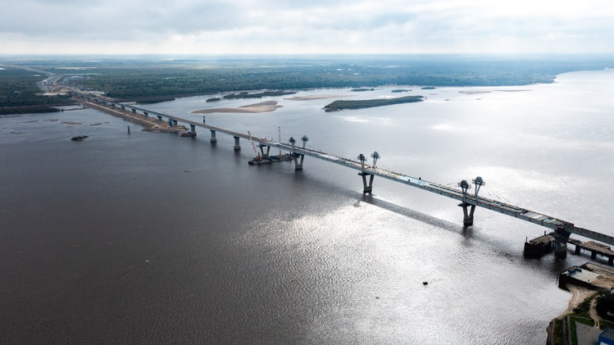
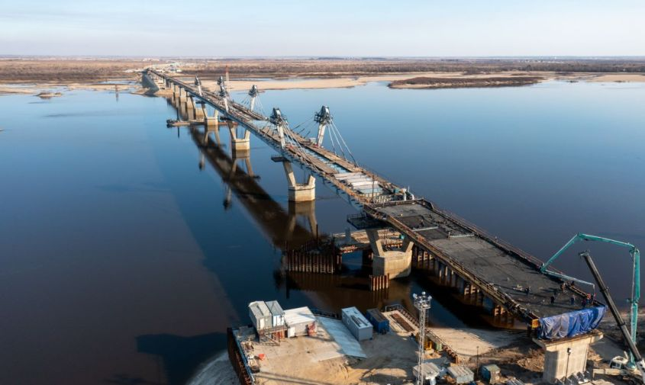

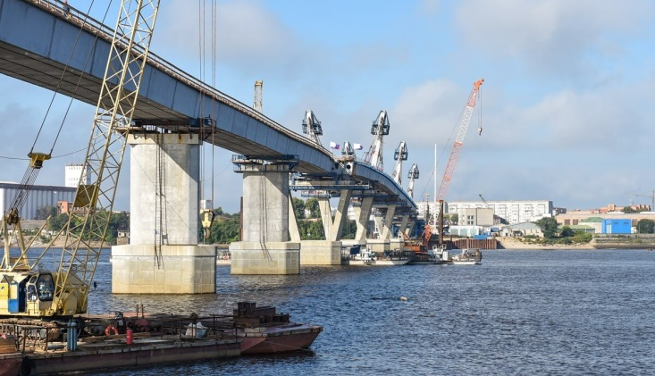
29
24
Bridge Construction Across the Zeya River in the City of Blagoveshchensk
Project initiators , contacts | The Government of the Amur Region
The purpose of the project, capacity/available documentation | Optimization of car flows by redistributing them into two directions (old and new bridges) The total length of the bridge crossing is 9007 m, of which 1933 m is the bridge directly over the Zeya River, 7074 m is the length of the approaches.
Period of implementation | 2020 – 2023
Project cost/required investments, million rubles. | 19 740,70
Form of attracting investment | budgetary funds
The degree of readiness of the project; provision of raw materials, land, resources | Design and estimate documentation has been developed. Positive conclusions of the Glavgosexpertiza of Russia were received. The land plots necessary for the construction of the facility are reflected in the territory planning project. A state contract has been signed for the construction of a bridge crossing over the Zeya River. At present, the overhang of the spans has been completed, the screw fortifications of the bridge are being installed, the construction of access roads adjacent to the highway "Entrance to Blagoveshchensk" is underway. It is included in the list of priority investment projects (PIP) of the region. Support measures for PIP.

Slide 25
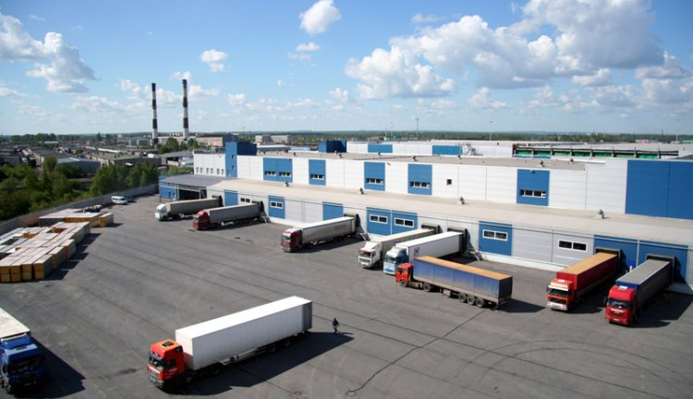
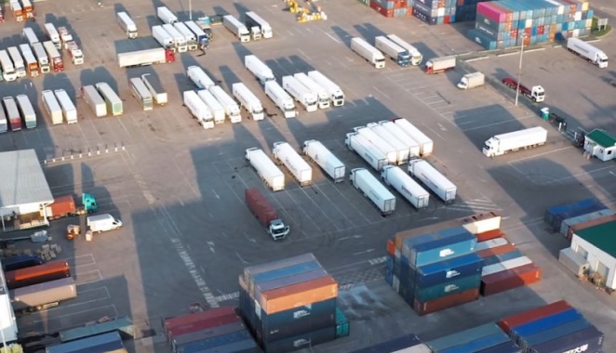
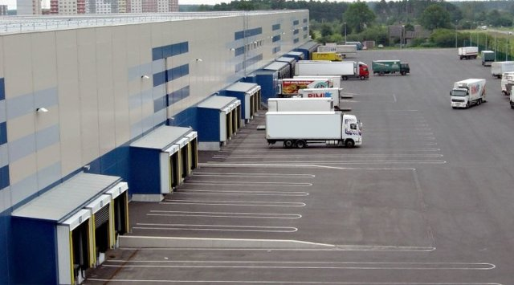
25
Construction of a modern transport and logistics terminal in Blagoveshchensk with a cargo handling volume of over 300,000 tons
Project initiators , contacts | Dispatcher LLC, TIN 2801157631, 101/2 Tenistaya street, Blagoveshchensk, e-mail: mail@artk.ru.
The purpose of the project, capacity/available documentation | Improving the quality, increasing the quantity and volume of transport and logistics services provided for organizations, enterprises and the population of the Amur region. Cargo handling volume of over 300,000 tons
Period of implementation | 2021 – 2025
Project cost/required investments, million rubles. | 564,56
Form of attracting investment | investor funds, loans
The degree of readiness of the project; provision of raw materials, land, resources | Preparatory stage. It is included in the list of priority investment projects (PIP) of the region. State support measures for PIP.

Slide 26



26
Creation, reconstruction, modernization and operation of infrastructure facilities of Blagoveshchensk International Airport (Ignatievo) for servicing international and domestic airlines
Project initiators , contacts | ABS Blagoveshchensk LLC, TIN 9705142240, Room No. 25, 6 floor, 26 Valovaya str., Moscow
The purpose of the project, capacity/available documentation | Construction of a new airport complex with a capacity of 600 passengers/hour, reconstruction of the existing terminal.
Period of implementation | 2021 – 2025
Project cost/required investments, million rubles. | 6 040,00
Form of attracting investment | budgetary funds and investor funds (PPP)
The degree of readiness of the project; provision of raw materials, land, resources | In progress. It is included in the list of priority investment projects (PIP) of the region. State support measures for PIP. It is necessary to create/reconstruct engineering infrastructure facilities (technological connection).

Slide 27



27
Development of the "Northern residential area“ of the city of Blagoveshchensk
Project initiators , contacts | Administration of the city of Blagoveshchensk, Andrey Anatolyevich Krolevetsky, tel. 8 (4162) 233-817.
The purpose of the project, capacity/available documentation | The project assumes the construction of: the microdistrict has an area of 237 hectares and a total housing area of 1.7 million square meters; 3980 places in preschool institutions; 8840 places for students in sports schools Available documentation: allotment of land for construction.
Period of implementation | 2007 – 2036
Project cost/required investments, million rubles. | 98 797,00
Form of attracting investment | requires to attract investment
The degree of readiness of the project; provision of raw materials, land, resources | In progress. Construction of engineering infrastructure and housing is underway, pre-project study of the construction of social infrastructure. It is included in the list of priority investment projects (PIP) of the region. State support measures for PIP.

Slide 28



28
Construction of the residential complex "Northern residential area“
Project initiators , contacts | Specialized Developer PIK Blagoveshchensk LLC, TIN 2801265933 503 office, 136 Zeyskaya str., Blagoveshchensk, Amur Region, 675029, tel. 8 (914) 152-70-00
The purpose of the project, capacity/available documentation | Providing housing for the population of the city of Blagoveshchensk in the amount of 10 120 people.Construction of apartment buildings with a total area of 188 181.52 sq. m.
Period of implementation | 2022 – 2035
Project cost/required investments, million rubles. | 16 183,65
Form of attracting investment | investor funds, loans
The degree of readiness of the project; provision of raw materials, land, resources | In progress. It is included in the list of priority investment projects (PIP) of the region. State support measures for PIP. By order of the Governor of the Amur Region dated August 16, 2022 No. 178-r, it was recognized as a large-scale investment project. Infrastructure required for the implementation of the investment project: Heat supply: construction of a gas boiler house with a capacity of 80 Gcal. Water supply: reconstruction of the water intake, completion of the water pipeline, quarterly networks and reconstruction of existing sites. Water disposal: reconstruction of the USC, the main collector, intra-canal networks, GNS-2, Severnaya, Meat-packing plant. Power supply: Construction of 10 kV networks from the substation OA DRSK to the load center of this microdistrict. Construction of a 10 kV distribution substation and 3 10/0.4 kV transformer substations with a total capacity of 6 MW, construction of 0.4 kV networks from 10/0.4 transformer substation to infrastructure facilities. The construction of the first stage of the residential complex is underway.

Slide 29



29
Development of the territory in the area of the village of Plodopitomnik of the municipal formation of the city of Blagoveshchensk "Ignatievskaya manor"
Project initiators , contacts | Bureyazhilpromstroy LLC, TIN 2801096964, 15a Nagornaya str., Blagoveshchensk, tel. 8 (914) 538-28-06
The purpose of the project, capacity/available documentation | Construction of apartment buildings, cottages and townhouses for 13.5 thousand people, providing housing for socially unprotected segments of the population - 1,008 people.
Period of implementation | 2010 – 2027
Project cost/required investments, million rubles. | 18 123,61
Form of attracting investment | requires to attract investment
The degree of readiness of the project; provision of raw materials, land, resources | In progress. Low-rise buildings and construction of engineering infrastructure facilities are underway. The development of working documentation for backbone networks is nearing completion. It is included in the list of priority investment projects (PIP) of the region. State support measures for PIP.

Slide 30



30
Modernization and reconstruction of the Blagoveshchensk Building Materials Factory (3rd stage)
Project initiators , contacts | Blagoveshchensk Building Materials Factory LLC, tel. 8 (4162) 338-238, e-mail: bzsm100@yandex.ru.
The purpose of the project, capacity/available documentation | Modernization of silicate brick production technology, including in order to improve product quality, purchase of equipment for production. Design capacity: silicate brick – 131 million pieces per year
Period of implementation | 2018 – 2025
Project cost/required investments, million rubles. | 224,36
Form of attracting investment | requires to attract investment
The degree of readiness of the project; provision of raw materials, land, resources | In progress. Currently, funds are being sought for the implementation of the final stage of construction. It is included in the list of priority investment projects (PIP) of the region. Support measures for PIP.

Slide 31



31
Plant for the production of aerated concrete products of the Amur region, the city of Blagoveshchensk
Project initiators , contacts | Blagoveshchensk GBZ LLC, 10 Zavodskaya str., Belogorye village, Blagoveshchensk, тел. 8 (4162) 209-991, e-mail: ukbh@yandex.ru.
The purpose of the project, capacity/available documentation | An increase of the production of aerated concrete blocks and slabs and, as a result, an increase of profits while selling blocks and slabs on the construction materials market Aerated concrete blocks – 90 thousand cubic meters, aerated concrete pipes – 30 thousand cubic meters per year
Period of implementation | 2013 – 2024
Project cost/required investments, million rubles. | 631,73
Form of attracting investment | investment is required to complete the construction
The degree of readiness of the project; provision of raw materials, land, resources | In progress. The final stage of construction and installation works on the construction of a cement warehouse, landscaping of on-site roads, commissioning is underway. Experimental production is being carried out. It is included in the list of priority investment projects (PIP) of the region. Support measures for PIP.

Slide 32



32
The cross-border cable car construction across the Amur river between Blagoveshchensk (Russia) – Heihe (China)
Project initiators , contacts | ZED Development LLC, TIN 7727797889, 50 Krasnoflotskaya street, Blagoveshchensk
The purpose of the project, capacity/available documentation | Development of international tourism in the region and related industries. Improving the quality and efficiency of passenger service when crossing the Russian-Chinese border near the cities of Blagoveshchensk – Heihe.Capacity – 457 people / hour, 1034 thousand people / year (in the direction of departure and arrival).
Period of implementation | 2019 – 2025
Project cost/required investments, million rubles. | 8 103,5
Form of attracting investment | holding's funds
The degree of readiness of the project; provision of raw materials, land, resources | In progress. It is included in the list of priority investment projects (PIP) of the region. State support measures for PIP. By order of the Governor of the Amur Region dated April 3, 2019 No. 53-r, it was recognized as a large-scale investment project. A business plan and a feasibility study of the project have been developed. A land plot was obtained for rent without bidding. It is a resident of the Priamurskaya TAD. Design and estimate documentation is in development, there is a FOB at the checkpoint. A positive conclusion of the Glavgosexpertiza of the Russian Federation and a construction permit was received. The technical concept of the project was agreed with the Chinese side, a number of joint documents were signed with the participation of the investor and representatives of the authorities of Heilongjiang Province, Heihe.

Slide 33



33
Complex development of the territory in quarter 404 of the city of Blagoveshchensk
Project initiators , contacts | Special Developer "Amurstroy" JSC, TIN 2801005205, 1 St. Innokenty lane, Blagoveshchensk tel. 8 (4162) 20-03-16.
The purpose of the project, capacity/available documentation | It is planned to build 11 apartment buildings for 952 apartments with a total living area of 42.8 thousand square meters (9, 10 and 14 floors).
Period of implementation | 2021 – 2025
Project cost/required investments, million rubles. | 2 449,28
Form of attracting investment | investor funds, equity contracts through escrow accounts
The degree of readiness of the project; provision of raw materials, land, resources | In progress. Of the 11 apartment buildings, six (from the 1st to the 6th) have been commissioned, four (8th, 9th, 10th, 11th) will be implemented by the end of 2023. The commissioning of the 7th house is scheduled for the 4th quarter of 2024, the transfer to equity holders - for the second quarter of 2025. By order of the Governor of the Amur Region dated February 28, 2018 No. 13-r, it was recognized as a large-scale investment project.

Slide 34



34
Grand city center "Tribune Hall", Blagoveshchensk, Amur region
Project initiators , contacts | Administration of the city of Blagoveshchensk, Andrey Anatolyevich Krolevetsky, tel. 8 (4162) 233-817.
The purpose of the project, capacity/available documentation | Reconstruction and improvement of the existing Lenin Square and its smooth transition to the alluvial area. Placement of a cultural center with a tribune, which will become a universal structure and can be used as an observation deck, a tribune for spectators, etc.
Period of implementation | 2020 – 2024
Project cost/required investments, million rubles. | 2 151,45
Form of attracting investment | budgetary funds
The degree of readiness of the project; provision of raw materials, land, resources | In progress. The construction of facilities envisaged in the framework of the project is underway.

Slide 35



35
Construction and operation of a plant for the production of tempered, fire-resistant and laminated glass, as well as architectural double-glazed windows for facade glazing
Project initiators , contacts | Home Master Glass LLC, TIN 2801266944, 12a Energeticheskaya street, Blagoveshchensk
The purpose of the project, capacity/available documentation | Construction and operation of a plant for the production of tempered, fire-resistant and laminated glass, as well as architectural double-glazed windows for facade glazing with a production capacity of 1 million square meters.
Period of implementation | 2023 – 2027
Project cost/required investments, million rubles. | 348,045
Form of attracting investment | investor funds
The degree of readiness of the project; provision of raw materials, land, resources | The preparatory stage. Development of a business plan. In progress. It is included in the list of priority investment projects (PIP) of the region. Support measures for PIP. By order of the Governor of the Amur Region dated November 2, 2022 No. 257-r, it was recognized as a large-scale investment project. It is planned to obtain the status of a resident of the Amurskaya TAD.

Slide 36



36
Complex development of the embankment of the Zeya River in the city of Blagoveshchensk (project "Cote d'Azur")
Project initiators , contacts | Administration of the city of Blagoveshchensk, Andrey Anatolyevich Krolevetsky, tel. 8 (4162) 233-817.
The purpose of the project, capacity/available documentation | The approximate housing stock is 166,320 square meters, construction of kindergarten and school.
Period of implementation | 2024 – 2035
Project cost/required investments, million rubles. | 20 000,00
Form of attracting investment | requires to attract investment
The degree of readiness of the project; provision of raw materials, land, resources | Planned for implementation, through the use of the mechanism of integrated development of territories. Blocks 263, 265 and 266 of the city (territory area of 26.4 hectares), a planning project for the 345 block is being developed, a planning project for the 346 block has been approved (approximate area of 11.1 hectares)

Slide 37



37
Creation of a new tourist route "Zeysky fairway"
Project initiators , contacts | Individual entrepreneur Tarasenko Oksana Viktorovna, TIN 280116553730, Natalino village, Natalinsky Selsoviet, Blagoveshchensk municipal district tel. 8 (914) 557-89-08.
The purpose of the project, capacity/available documentation | Organization of rafting on the river Zeya, with the aim of forming the need for a healthy lifestyle, introducing young people and the age population to sports activities in the fresh air.
Period of implementation | 2021 - 2024
Project cost/required investments, million rubles. | 3
Form of attracting investment | requires to attract investment
The degree of readiness of the project; provision of raw materials, land, resources | In the process of attracting investment. Investment proposal. Activities within the framework of the project are planned to be carried out on a land plot with cadastral number 28:10:015001:75 – "Rainbow" recreation center (97th km. Highways Svobodny – Blagoveshchensk). It is planned to purchase 6 units of electric catamarans, prepare the shore for a smooth descent and entry into the water, organize a rental point and a storage place for equipment.

Slide 38



38
Purchase of equipment for the "Snowflake“ recreation center
Project initiators , contacts | Individual entrepreneur Kolotova Natalia Vyacheslavovna, TIN 280100699082, 210 office, 7 Tchaikovsky str., Blagoveshchensk, тел. 8 (914) 590-72-09.
The purpose of the project, capacity/available documentation | Purchase of equipment, including tourist equipment, in order to increase the flow of tourists, create new jobs.
Period of implementation | 2023 – 2024
Project cost/required investments, million rubles. | 10
Form of attracting investment | requires to attract investment
The degree of readiness of the project; provision of raw materials, land, resources | In the process of attracting investment. Investment proposal. There are land plots with cadastral numbers 28:01:170174:70, 28:01:170174:181 (Blagoveshchensk, northern planning area, Mokhovaya Pad settlement). Availability of infrastructure: rest house (3 floors, 15 rooms, 2 banquet halls for up to 50 people, sauna), 16 gazebos (with a capacity of 10 to 60 people), outdoor swimming pool. There is a connection to electric networks, water supply – a well, drainage – a septic tank.As part of the project, it is planned to purchase playgrounds, equipment for a rental point, recreation areas.

Slide 39



39
Creation of a new tourist route involving walking and cycling on the territory of the "Rainbow" recreation center
Project initiators , contacts | RUS GPZ LLC», TIN 2801141832 Natalino village, Natalinsky Selsoviet, Blagoveshchensk municipal district, tel. 8 (914) 557-89-08.
The purpose of the project, capacity/available documentation | Creation of a new tourist route, involving walking and cycling, in order to form the need for a healthy lifestyle, to involve young people and the elderly population in spending time outdoors.
Period of implementation | 2022 - 2024
Project cost/required investments, million rubles. | 2
Form of attracting investment | requires to attract investment
The degree of readiness of the project; provision of raw materials, land, resources | In the process of attracting investment. Investment proposal. Activities within the framework of the project are planned to be carried out on a land plot with cadastral number 28:10:015001:75 – "Rainbow" recreation center (97th km. Highways Svobodny – Blagoveshchensk). It is planned to purchase bicycles (adults, teenagers, children), electric scooters, skis, organization of a rental point, storage of equipment, changing rooms, lighting of the territory, preparation of trails, paths, transportation and removal of soil, landscaping.

Slide 40



40
Organization of the rope park, modernization of the sports and children's playground of the Golden Dragon hotel complex
Project initiators , contacts | Dragon LLC, TIN 2801004610, 4th km. Ignatievsky Highway, Blagoveshchensk, tel. 8 (924) 679-69-51.
The purpose of the project, capacity/available documentation | Organization of leisure activities for preschoolers and schoolchildren of all age groups (involvement in a healthy lifestyle), introduction into daily practice of outdoor activities, hardening and health improvement of children and youth.
Period of implementation | 2021 – 2024
Project cost/required investments, million rubles. | 3
Form of attracting investment | requires to attract investment
The degree of readiness of the project; provision of raw materials, land, resources | In the process of attracting investment. Investment proposal. Activities within the framework of the project are planned to be carried out on a land plot with cadastral number 28:01:000000:220 – the territory of the Golden Dragon hotel complex (Blagoveshchensk, 4th km. Ignatievsky highway). It is planned to organize the work of the rope park, purchase equipment for passing the trails of the rope park, modernize sports and children's playgrounds (manufacture of injury-safe all-season coating), equip an additional recreation area at the existing pool, install a children's pool.

Slide 41




41
Construction of Barnhouse-style houses on the territory of the AmurGlamping eco-hotel
Project initiators , contacts | Individual entrepreneur Evseeva Lyudmila Vasilyevna, TIN 280120081142, 1 AmurGlamping, Mokhovaya Pad, Blagoveshchensk, tel. 8 (963) 804-87-64.
The purpose of the project, capacity/available documentation | Increasing the flow of tourists, creating recreational conditions that combine the comfort of a hotel room with the possibility of outdoor recreation.
Period of implementation | 2023 – 2024
Project cost/required investments, million rubles. | 4
Form of attracting investment | requires to attract investment
The degree of readiness of the project; provision of raw materials, land, resources | In the process of attracting investment. Investment proposal. It is planned to build 3 Barnhouse-style houses with 8 beds.

Slide 42

42
Legal regulation of investment and business activities
Federal Law #39-FZ of February 25, 1999 “On Investment Activities In The Russian Federation, Realizing In The Form Of Capital Investment”
Federal Law #160-FZ of July 09, 1999 “On Foreign Investment In The Russian Federation”
Federal Law #224-FZ of July 13, 2015 “On A Public–Private Partnership In The Russian Federation and On Amendment Of Legislation Of The Russian Federation”
Federal Law #209-FZ of July 24, 2007 “Оn Developing SME In The Russian Federation”
«The Land Code of The Russian Federation» #136-FZ of October 25, 2001 (paragraph 39.6 “Cases Of Granting Land Plots For Rent Through Bidding or Without It, Which Are Owned By State or Municipal Government”)
«Town Planning Code of The Russian Federation» #190-FZ of December 29, 2004 (part 2 paragraph 51 “Planning Permission”)
Amur Region Law #374-OZ of September 05, 2007 “On Investment Activities In The Amur Region”
Amur Region Law #298-OZ of January 11, 2010 “On Supporting and Developing SME In The Amur Region”
Amur Region Law #389-OZ of October 04, 2010 “On Reduced Income Tax Rates”
Amur Region Law #266-OZ of November 28, 2003 “On Corporate Property Tax In The Amur Region”
Amur region law #321-OZ of February 14, 2014 “On the Implementation of Certain Provisions of the Tax Code of the Russian Federation regarding the implementation of regional investment projects"
Amur region law #528-OZ of May 5, 2015 “On the establishment of a zero tax rate levied in connection with the application of the simplified taxation system for taxpayers - individual entrepreneurs“
Amur region law #93-OZ of October 9, 2012 “On the patent system of taxation in the Amur region”
Decree of the Government of the Russian Federation #141 of February 9, 2021 “On Approval of the Rules for Granting Subsidies from the Federal Budget to Russian Credit Organizations and the State Development Corporation "VEB.RF“ on compensation of the income they have not received on loans issued at a preferential rate to investors for the implementation of investment projects necessary for the sustainable development of domestic and inbound tourism, and on amendments to the regulations on the Government Commission for the development of Tourism in the Russian Federation“
Decree of the Government of the Russian Federation #1704 of October 19, 2020 "On Approval of the Rules for Determining New Investment Projects for the Implementation of which the Budget Funds of the Subject of the Russian Federation Released as a Result of a Decrease in the Volume of Repayment of the Debt of the Subject of the Russian Federation to the Russian Federation on budget loans are subject to direction for the Implementation by the Subject of the Russian Federation of budget investments in infrastructure facilities“
Decree of the Government of the Russian Federation #1740 of October 12, 2021 "On Approval of the Rules for Writing off the Debt of a Subject of the Russian Federation to the Russian Federation on Budget Loans, Methods for Calculating the Receipt of Tax Revenues to the Federal Budget from the Implementation of New Investment Projects, in the amount of receipts to the Federal Budget of which the Government of the Russian Federation has the right to write off the debt of Subjects of the Russian Federation on budget loans, and on invalidation of the Decree of the Government of the Russian Federation No. 1705 dated 19.10.2020"

Slide 43
43
Legal regulation of investment and business activities
Decree of the Governor of the Amur region #217 of April 4, 2011 “On approval of the procedure for forming a list of priority investment projects"
Decree of the Government of Amur Region #186 of April 18, 2013 № 186 “On organization of work on providing tax incentives”
Decree of the Government of Amur Region #697 of November 19, 2014 “On Investment Projects Support In The “One Stop” Regime”
Decree of the Government of Amur Region #423 of July 1, 2021 “On Approval of the Procedure for Granting Subsidies to Legal Entities for Reimbursement of Part of the Costs of Connecting (Technological Connection) Capital Construction Facilities to the Electrical Networks of Engineering and Technical Support for the Implementation of Priority Investment Projects of the Amur Region Coordinated by the Ministry of Economic Development and External Relations of the Amur Region in accordance with the Order of the Government of the Amur Region dated 08.08.2011 No. 90-p "On approval of the list of priority investment projects of the Amur Region" “
Decree of the Government of Amur Region #796 of October 13, 2021 "On approval of the Procedure for granting subsidies from the regional budget for reimbursement of part of the costs in connection with the implementation of priority investment projects of the Amur Region“
Resolution of the Blagoveshchensk city Duma #16/80 of September 24, 2020 "On property support for small and medium-sized businesses“
Resolution of the Blagoveshchensk city Duma #34/114 of October 25, 2007 “On Land Plots Payment, Which Are Owned By Municipal Division Of Blagoveshchensk City”
Resolution of the Blagoveshchensk city Duma #4/27 of November 27, 2014 “On Mortgage Fund Of Municipal Division Of Blagoveshchensk City”
Resolution of the Blagoveshchensk city Duma #51/128 of December 20, 2018 “The Socio-economic Development Strategy of the Municipality of Blagoveshchensk for the Period until 2025”
Resolution of the Blagoveshchensk city Duma #6/51 of December 24, 2019 “On Amendments to the strategy of socio-economic development of the Municipality of Blagoveshchensk for the period up to 2025, approved by the resolution of the Blagoveshchensk City Duma of December 20, 2018 No. 51/128”
Decree of the Blagoveshchensk city administration #4255 of December 24, 2018 “On the Plan of Measures of Implementation of the Socio-economic Development Strategy of the Municipality of Blagoveshchensk for the Period until 2025 Approved by the Resolution of the Blagoveshchensk city Duma #51/128 of December 20, 2018”
Decree of the Mayor of Blagoveshchensk city #20 of June 30, 2016 “On Determination Of The Local Government Of Municipal Division For The Exercise Of Powers In The Municipal-Private Partnership Sphere”
Decree of the Blagoveshchensk city administration # 4387 of December 20, 2019 “On the Implementation of Certain Provisions of the Legislation on Concession Agreements, Municipal-Private Partnership in the Territory of the Municipal Formation of the City of Blagoveshchensk“
Decree of Blagoveshchensk city administration #4129 of October 03, 2014 “SMEs and Tourism Development in Blagoveshchensk Town Area”
Decree of Blagoveshchensk city administration #1197 of April 24, 2017 “On Approval Of Investment Strategy Of Municipal Division to 2025”

Slide 44
44
Legal regulation of investment and business activities
Decree of Blagoveshchensk city administration #3472 of October 09, 2017 “On Regulation’s Approval About Municipal Support For Investment Activity”
Decree of Blagoveshchensk city administration #3484 of September 15, 2015 “On Regulatory Impact Assessment Of Municipal Law’s Projects And Legal Evaluation Of Municipal Law, Concerning Business And Investment Activities”
Decree of Blagoveshchensk city administration #2691 of July 17, 2015 «On Approval Of Investment Projects Support In The “One Stop” Regime On The Territory Of Blagoveshchensk City”
Decree of Blagoveshchensk city administration #3040 of September 11, 2017 “On Creating The Council For Improving Investment Climate and Developing Entrepreneurship Under The Blagoveshchensk City Mayor”
Decree of Blagoveshchensk city administration #2415 of June 25, 2015 “On Approval of The Administrative Regulation of Blagoveshchensk City “Realization Of The Buy-Out Offer For Municipal Property Owned by The Municipal Division Of Blagoveshchensk City and Leased by SME”
Decree of Blagoveshchensk city administration # 266 of February 02, 2017 “On Regulation’s Approval About Guarantees Of Municipal Division Of Blagoveshchensk City”
Decree of Blagoveshchensk city administration #1066 of March 10, 2015 “On The Procedure For Granting Pledged Funds Of Municipal Division in Blagoveshchensk City As A Pledge”
Decree of Blagoveshchensk city administration #3894 of November 10, 2020 “On approval of the List of property and Land Plots owned by the Municipality of the city of Blagoveshchensk, and Land Plots, state Ownership of which is not delimited, intended for the Provision of Ownership and (or) use to small and medium-sized businesses and organizations that form the infrastructure of support for small and medium-sized businesses medium-sized businesses"
Decree of Blagoveshchensk city administration #149 of January 14, 2022 “On approval of the rules of land use and development of the municipal formation of the city of Blagoveshchensk"

Slide 45
The support of investment and business activities
45
Autonomous Nonprofit Organization «The Amur Region Investment Agency» (Autonomous Nonprofit Organization includes Export support center of Amur region)
Development of business-plans and feasibility study of the projects.
Assistance in preparing all necessary documents for project finance, including state support.
Organizing and holding fairs, presentations and other events, international business missions.
Organizational and informational assistance of investment projects, including interaction with the government in the "one stop" regime.
Assistance in protecting intellectual property abroad.
Assistance in entering international electronic trading platforms for SMEs.
212, 213 office, 2 flour
38 Amurskaya street, Blagoveshchensk,
Amur region, 675000
e-mail: invest.amurobl@mail.ru
www.invest.amurobl.ru
Export support center
тел. (4162) 772-609
e-mail: info@amurexport
Nonprofit organization «Credit Support Fund of SME of Amur Region» (Nonprofit organization includes Enterprise support center and Cluster development center)
Provision of guarantees on obligations of SME (loan, leasing and bank guarantee agreements)
Financial, marketing, informational, law support for SMEs activities
Organize and conduct seminars, training courses, master classes, forums
Assistance in promoting new products (jobs, services) of members of territorial clusters; assistance in promoting products (jobs, services) on the congress and exhibition events;
Support in taking part in the events of large international and Russian exhibitions.
38 Amurskaya street,
Blagoveshchensk, Amur region, 675000
tel. +7 (4162) 77 26 46,
+7 (965) 671 10 70;
https://business.amurobl.ru,
amurfondgarant.ru

Slide 46
The support of investment and business activities
46
Association for Promotion and Development of Entrepreneurship in the Social Sphere
Protection of interests of social entrepreneurs, development of interaction with authorities of different levels, development of interaction with public associations of entrepreneurs and other institutions for supporting social entrepreneurship
55 Ostrovskogo street,
Blagoveshchensk, Amur Region, 675000
e-mail: marianna8307@mail.ru
Regional Association of Employers
"Amur Region Union of Industrialists, Entrepreneurs and Employers"
tel: +7 (4162) 51-07-65
e-mail: Pvb-amur@mail.ru
class@drsk.ru
http://amur.rspp.ru
Legal acts regulatory impact assessment;
International cooperation services ;
Social responsibility and social and labor relations consulting;
Union "Amur Chamber of Commerce and Industry"
Representation and protection of the rights and interests of business; assistance in the settlement of disputes between business entities; assistance in the development of education and training of personnel for entrepreneurial activities; assistance in patenting of inventions, utility models, industrial designs, registration of trademarks, etc. Information and consulting services on the organization and conduct of business activities; independent evaluation of various types of property; services in foreign economic and commercial activities; independent services in the field of labor protection, official transfers.
314 office, 1 Chaikovskogo street,
Blagoveshchensk, Amur Region, 675000
phone number of the mountain line/reception:+7 (929) 475-72-03;
e-mail: info@tppamur.ru
http://www.amur.tpprf.ru

Slide 47


The support of investment and business activities
47
Council on Improving the Investment Climate and Development of Entrepreneurship
under the Mayor of Blagoveshchensk
64 Pushkina street,
Blagoveshchensk, Amur Region, 675000
tel: (4162) 58-21-92
+7 (914) 558-21-92
e-mail: opora-amur@mail.ru
www.opora-amur.ru
Amur regional branch of the All-Russian public organization of SME
"OPORA of Russia»
Legal support of activity of subjects of SME
Consulting services to promote business development
Conducting seminars, conferences, forums, roundtables for SME
118 office, 301 Zeyskaya street ,
Blagoveshchensk, Amur Region, 675000;
tel. (4162) 37-70-10,
+7 (909) 817 70 10;
e-mail: Dellorosamur28@mail.ru;
https://deloros.ru/regiony/dalnevostochnyy/amurskaya-oblast/

Slide 48
The support of investment and business activities
48
SAI of the Amur region "Multifunctional center for the provision of state and municipal services in the city of Blagoveshchensk"
The organization of providing state and municipal services in the “one stop” regime
4/2, 6/1, 8/2 50 years of October street, Blagoveshchensk, Amur region, 675000
tel. 8 909 817 08 56,
8 914 387 16 06
e-mail: 89143871606@mail.ru,
amurobl@ombudsmanbiz;
Telegram-channel :
t.me/RUP_Amur28
Autonomous Nonprofit Organization “Amur Regional Microcredit Company”
Providing access for small and medium-sized enterprises and organizations forming the infrastructure supporting small and medium-sized enterprises in the Amur Region to financial resources by providing microloans
38 Amurskaya street,
Blagoveshchensk, Amur Region, 675000
tel: +7 (4162) 770-730,
+7-914-556-36-06
https://бизнескредит28.рф
Amur Region Business Rights Commissioner – Radchenko Igor Pavlovich
Protection of the rights and legitimate interests of business entities.
Control over the observance of the rights and legitimate interests of entrepreneurs by federal executive authorities, executive authorities of the subjects of the Russian Federation, local self-government bodies.
Promoting the development of public institutions focused on protecting the rights and legitimate interests of business entities.
Interaction with the business community.
Participation in the formation and implementation of state policy in the field of business development.
Blagoveshchensk, Amur Region, 675000,
tel. 8 909 817 08 56,
8 914 387 16 06
e-mail: 89143871606@mail.ru,
amurobl@ombudsmanbiz;
Telegram-channel:
t.me/RUP_Amur28

Slide 49

Reference information for investors and entrepreneurs
49
Contacts
Nozhenkin Maxim Sergeevich - Deputy Mayor of Blagoveshchensk, tel: 7 (4162) 233-714
Krolevetsky Andrey Anatolievich - Head of the Architecture and Urban Planning Department of Blagoveshchensk City Administration, tel: 7 (4162) 233-817, 233-815
Sidorova Yuliya Igorevna - Head of the Land Department of Blagoveshchensk City Administration, tel: 7 (4162) 233-860
Bogdanova Olga Albertovna - Chairman of the Property Management Committee of the municipality of Blagoveshchensk,
tel: 7 (4162) 223-701
Department for Economic Development and Investments of Blagoveshchensk City Administration
131 Lenin street, Blagoveshchensk, Amur Region, 675000
Head of the Department - Sokolovskaya Elena Alexandrovna, tel: +7 (4162) 233-900
Enterprise and Investment Development Department – 105 office,
tel. +7 (4162) 233-911, +7 (4162) 233-912, +7 (4162) 233-913
e-mail: otdel.opin@admblag.ru
Internet address: www.благовещенск.рф, www.admblag.ru

Slide 50

Welcome to Blagoveshchensk!

